Slide 1
Technical and Data Management Plan*
*Data Management Plan on Je-S
Notes:
To edit the background image, select ‘Format’ from the PowerPoint menu and ‘Slide Background’ from the drop-down menu. Within the new list of options that appears on the right of the screen, select the ‘File’ button under ‘Insert picture from’ and select your image from your file browser.

Slide 2
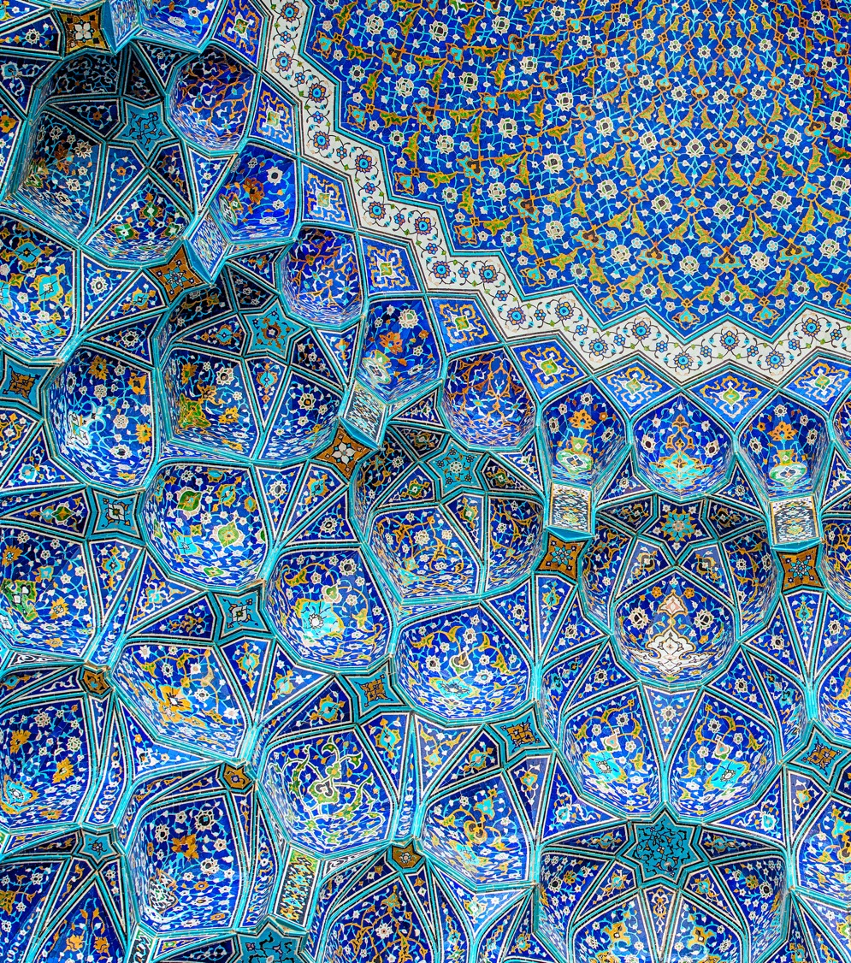
What is ‘data’ in the Technical and Data Management Plan?
Notes:
To replace photo with one of your own: 1) Send the geometric shape overlay to the back – Right-Click > Send to Back > Send to Back. 2) Replace image – use the guides provided to correctly position it. 3) Send your image to the back so that the geometric overlay re-appears over the image.

Slide 3
Technical and Data Management Plan in four pages: How to structure it?
Notes:
To replace photo with one of your own: 1) Send the geometric shape overlay to the back – Right-Click > Send to Back > Send to Back. 2) Replace image – use the guides provided to correctly position it. 3) Send your image to the back so that the geometric overlay re-appears over the image.

Slide 4
Sections 1-8
Section 1: Summary of Data Management, Digital Technologies, and Digital Outputs
Section 2: Data Acquisition, Processing, Analysis and Use
Section 3: Technical Leadership and Support, and Relevant Experience
Section 4: Storage, Preservation, and Sustainability
Section 5: Ethical and Legal considerations
Section 6: Use of Artificial Intelligence
Section 7: Data Aggregation and Linked Data
Section 8: Crowdsourcing Technologies

Slide 5
Section 1: Summary of Data Management, Digital Technologies, and Digital Outputs
Briefly introduce the types of data the research will create.
Why did you decide to use these data types? In what formats will they be? What standards will they adopt?
Provide a brief and clear description of the digital technology and/or digital output being proposed.

Slide 6
Section 2: Data Acquisition, Processing, Analysis and Use
Give details on the proposed methodologies that will be used to create the data.
Outline the technical development process from the point of data capture or data creation through to final delivery (in the case of a digital output) or analysis (in the case of a digital process).

Slide 7
Section 3: Technical Leadership and Support, and Relevant Experience
Provide information about the individuals, facilities or institutions that will be responsible for the technical components of the project (with examples of their most relevant experience for each component).

Slide 8
Section 4: Storage, Preservation, and Sustainability
Section 4.a: Short-term Data Storage
How will the data be stored in the short term?
What backup will you have in the in-project period to ensure no data is lost?
Costs of storage – why are these appropriate?

Slide 9
Section 4 : Storage, Preservation, and Sustainability (continues)
Section 4.b: Long-term Data Storage (Preserving* Your Data)
*By preservation we mean: the storage of project data beyond the period of funding.
Provide information about plans for preserving the project's data beyond the period of funding.
Will the data need to be updated? Include future plans for updating if this is the case.

Slide 10
Section 4: Storage, Preservation, and Sustainability (continues)
Section 4.c: Ensuring Continued Access and Use of Your Digital Outputs (Sustainability*)
*By sustainability we mean: the plans for ensuring that a digital output remains publicly accessible and usable
Provide information about plans for ensuring that outputs remain sustainable in the sense of accessible and usable beyond the period of funding.
Will the data be open or will you charge for it? Justify if charging to access the data.

Slide 11
Section 5: Ethical and Legal considerations
Consider any legal and ethical considerations of collecting the data (e.g. selection bias in crowdsourcing).
Discuss legal and ethical considerations around releasing and storing the data – e.g. anonymity of any participants, following promises made to participants.
Consider the overall impact of IP, copyright and other rights (e.g. indigenous rights) during the period in which the digital output will be publicly accessible.

Slide 12
Sections 6-8:
To be addressed only if relevant to your project!

Slide 13
Section 6: Use of Artificial Intelligence (including Machine Learning, Data Science, Computer Vision, Natural Language Processing etc.)
Section 6.a: How and when AI is applied
Explain which AI techniques will be used, and at which part of the process.
Outline the degree of technical novelty in these (e.g. whether you are planning to use existing or to develop novel architectures; whether you plan to use pre-trained models, or fine-tune existing models, or train new models from scratch).

Slide 14
Section 6: Use of Artificial Intelligence (including Machine Learning, Data Science, Computer Vision, Natural Language Processing etc.)
Section 6.b: Potential biases in the algorithms and training sets
Outline how you plan to detect and address potential biases in any AI models used in the project.

Slide 15
Section 7: Data Aggregation and Linked Data
Define the standards adopted for the aggregation of the project’s data.
Outline how the project will balance preserving original complexity with standardising for interoperability.

Slide 16
Section 8: Crowdsourcing Technologies
Explain which crowdsourcing technologies will be used and at which part of the process.
Describe whether you are planning to use data standards for annotation (e.g. IIIF, W3C).

Slide 17
Notes:
The abstract pattern can be removed or repositioned if required. Be careful to ‘Send to Back’ so that it does not obscure any important information.

Slide 18
Arts and Humanities Research Council
@AHRCpress
AHRCpress

